Slide 1
Life Plan Consulting Group 18
Recording: https://usc.zoom.us/rec/play/d9BubO5quqeRXvMSXKyTBqyVtVRPG7UBYsBFi3QXzdW8P-SXZtLfXK-m4g4zTxVtpr2Nlfq9sLoH6I0K.FtVgxgE9Z8eqGCpt?autoplay=true&startTime=1669162718000
Jiaqi Han
Ruohan Zhang
Yongyi Ji
Wenxiong Huang

Slide 2
Project Framework
EDA report
Project Overview
Modeling
Conclusion and recommendation
Decision Tree
Logistic regression
Univariant
Bivariant
Chi - Square result

Slide 3
Project Overview
Business Background
Getting better income is an important life goal for many people. However, suggestions to people with different backgrounds may also be very different. In this condition, a life consulting company is needed to give valuable advices to customers to help them win a better life.
Business objectives
Based on analysis of data from the real world, we deliver specific advices to customers who are seeking for higher income. We equally value all communities and insist to help every customers getting higher revenue.
Data source
A dataset of people from different background with more or less than 50K income

Slide 4
EDA - initial observation
● Data appears to be clean
No missing value
No significant outlier
● Dropped Column:
education.num (highly related to Education)
native country (most of the people are from United States)
fnlwgt (no meaning)

Slide 5
EDA - Summary
Logical Groupings of Attributes
Measures (3) :
- Background of the person
- age
- Investment
- Capital_income
- Work duration
- Hour per week
Categories (6)
- Work: Workclass, occupation
- Education:Education
- Background:
- race
- sex
- Marital
- Marital_status
- Income: Y

Slide 6
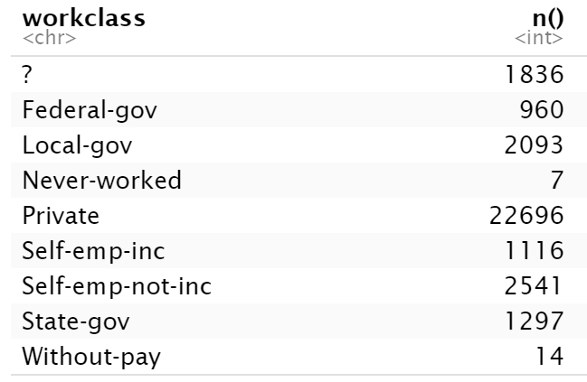
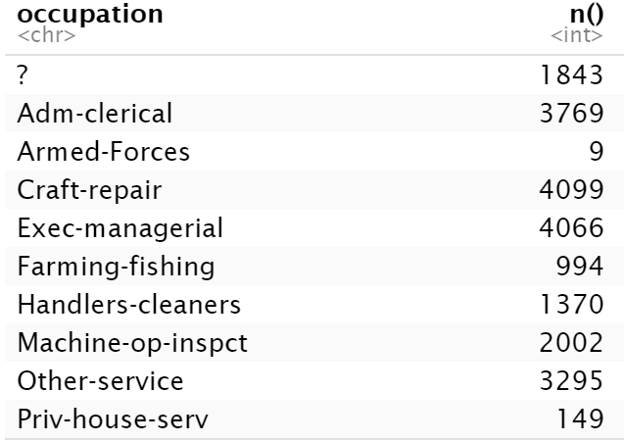
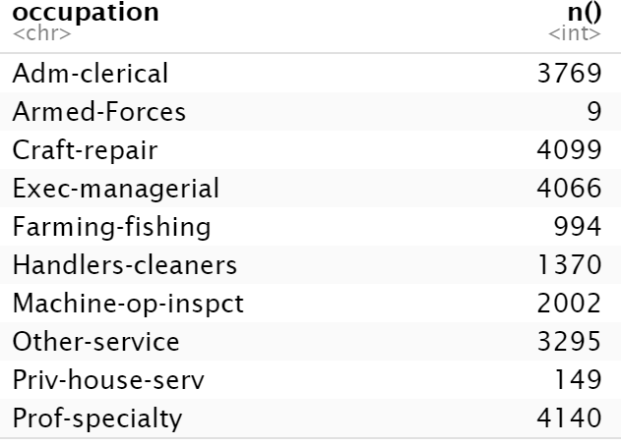
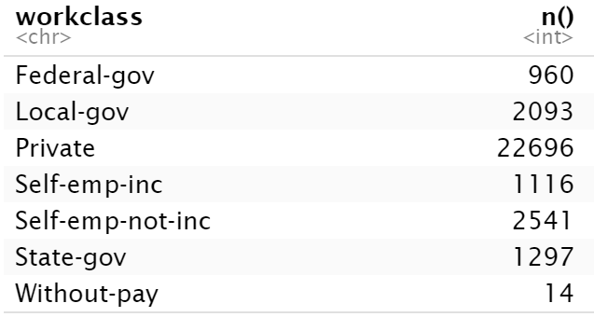
EDA - Data processing - Unknown
Before
Now

Slide 7
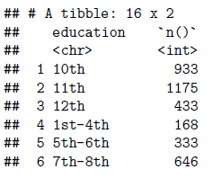
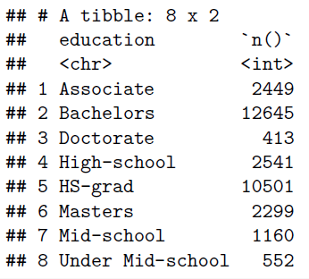
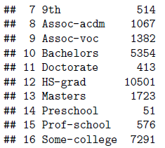
EDA - Data Processing - Education
Before
Now

Slide 8
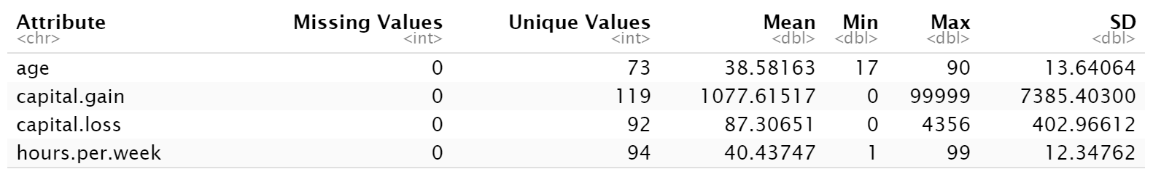
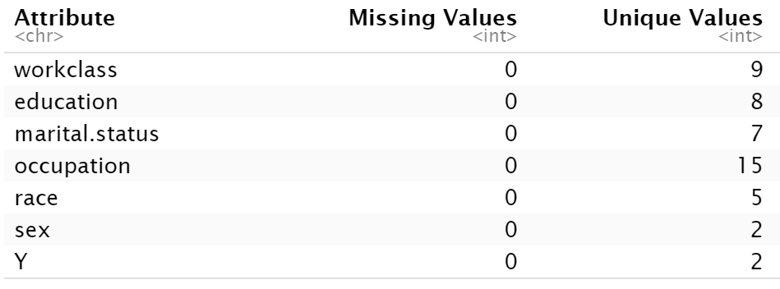
EDA - Summary

Slide 9
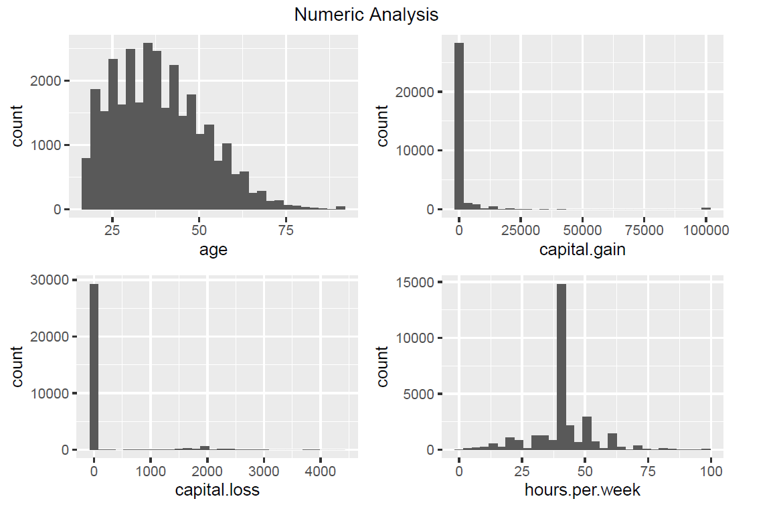
EDA - Univariate Analysis - Numeric
Most people are grown man
Most people do not invest

Slide 10
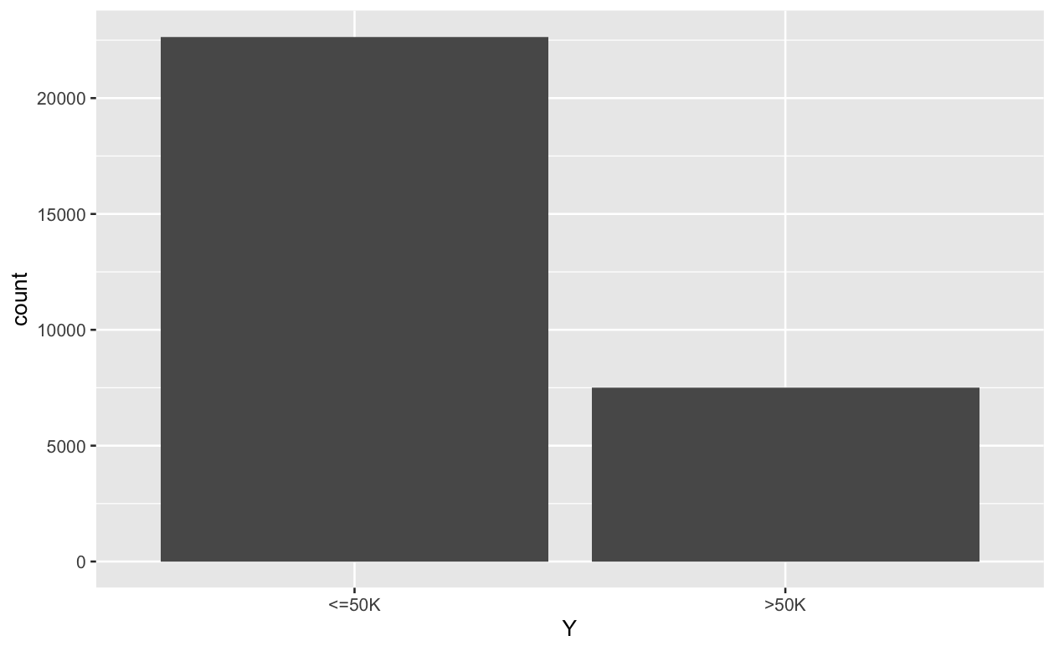
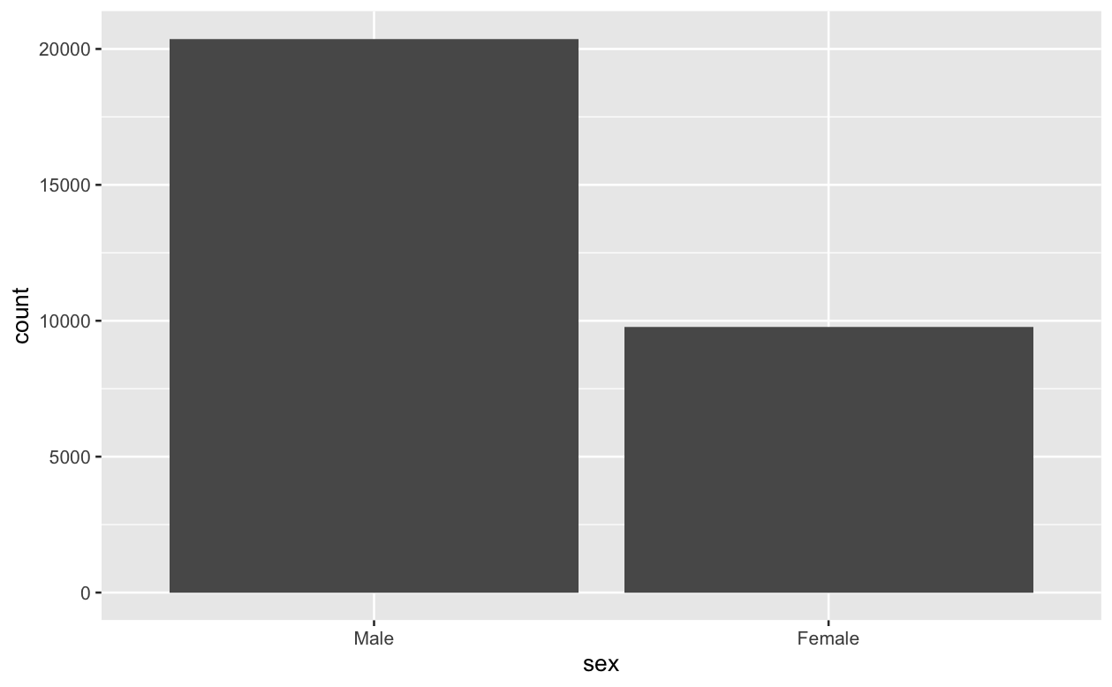
EDA - Univariate Analysis - Character
Most people has income below 50k
Most people are male

Slide 11
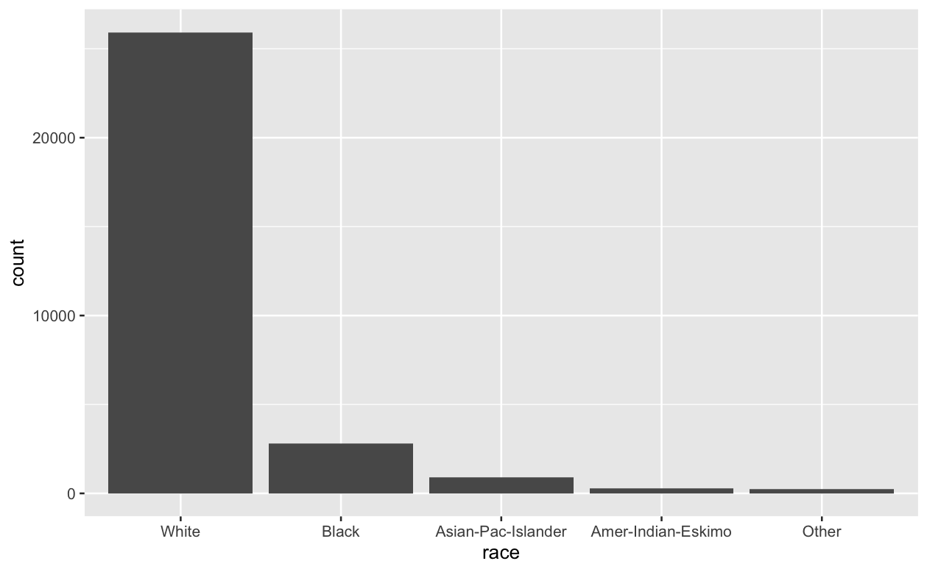
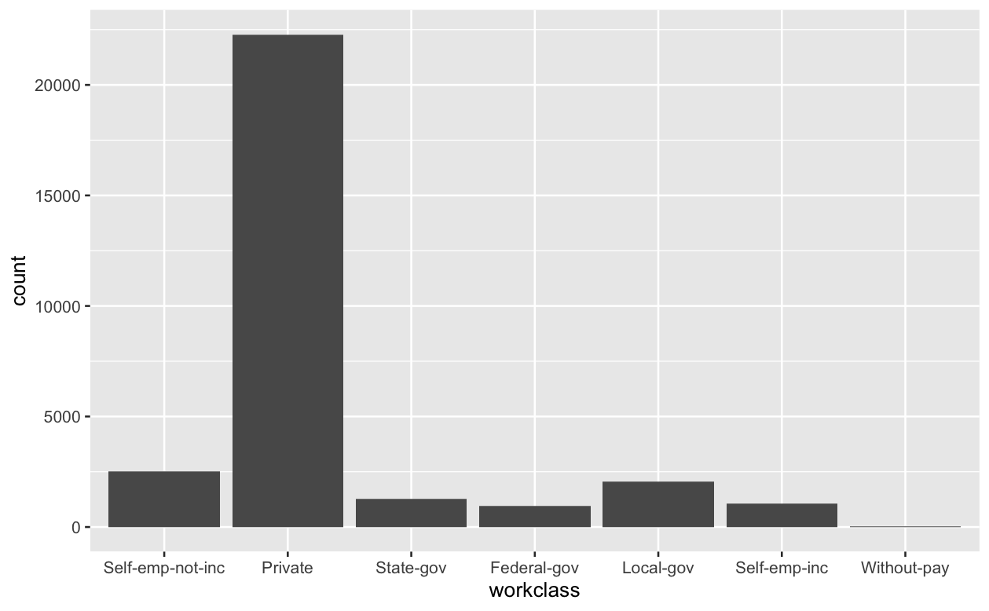
EDA - Univariate Analysis - Character
White people has the highest percentage
Most of people work as private

Slide 12
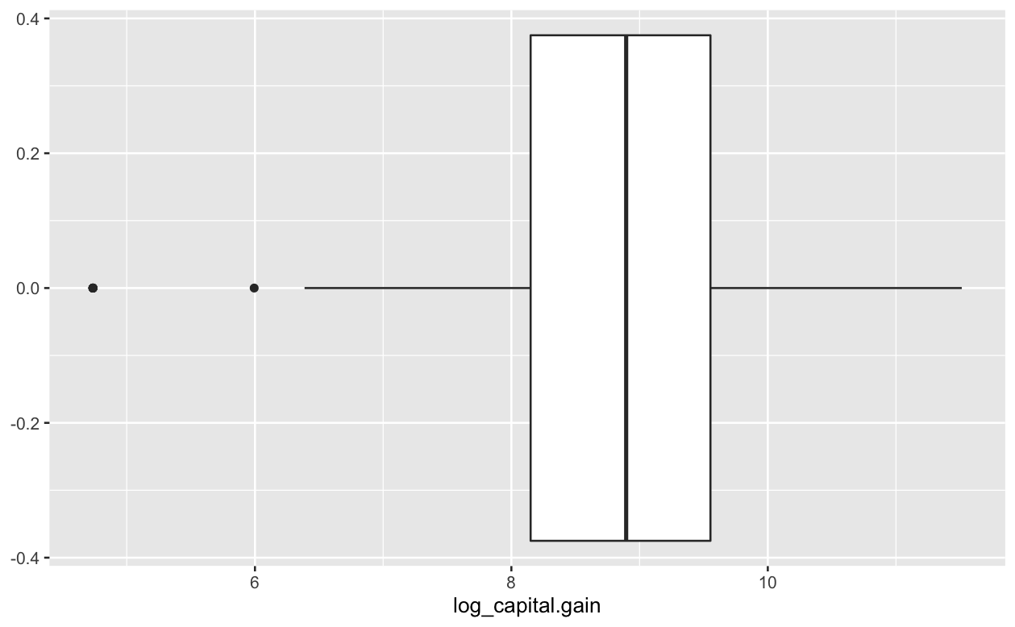
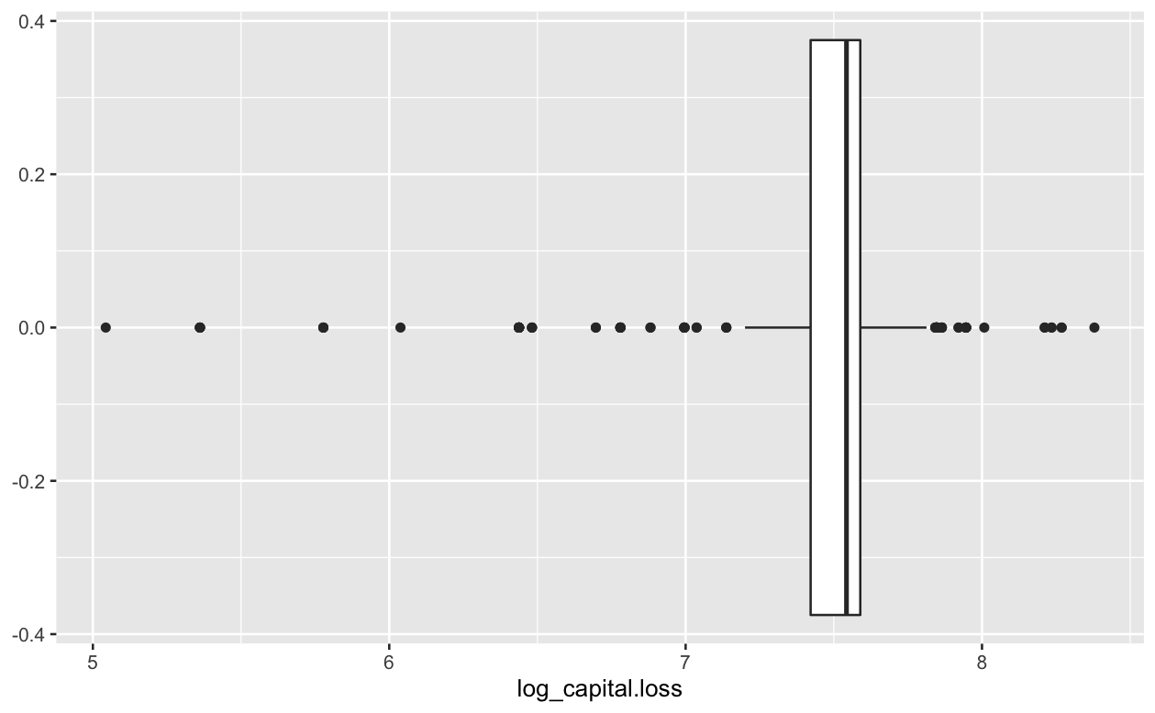
EDA - Univariate Analysis - Data transform
Since capital gain and capital loss are highly skewed, we take the log form of them so that the model assumption could be better satisfied

Slide 13
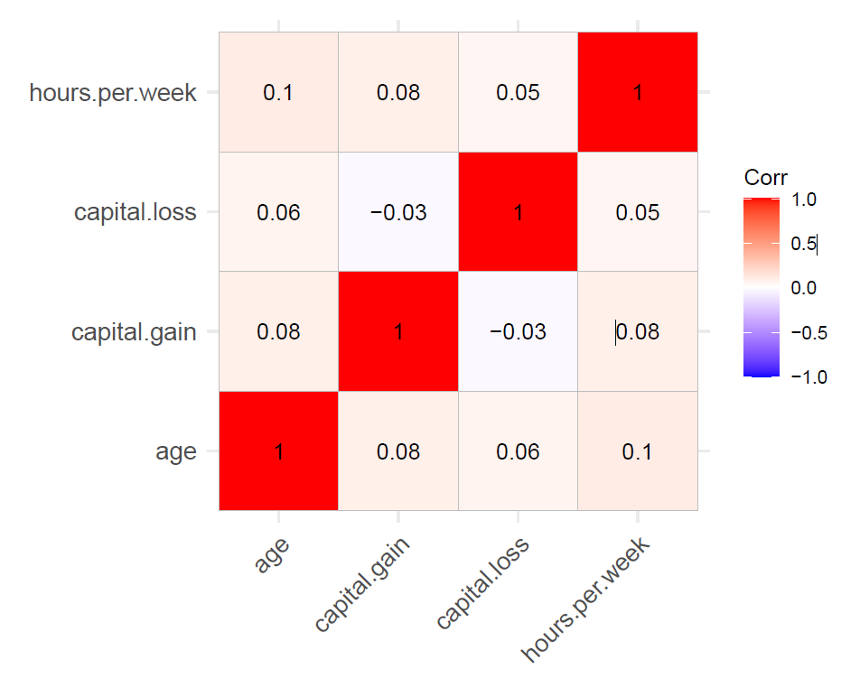
EDA - Bivariate Analysis – Correlation Matrix
We have only 4 numeric attributes
No independent variables are highly correlated with each other.

Slide 14
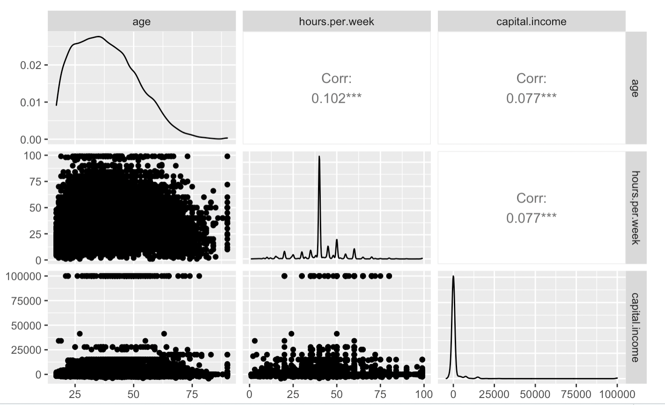
EDA - Bivariate Analysis – Measure/Measure
●No linear relationship among most numeric attributes.

Slide 15
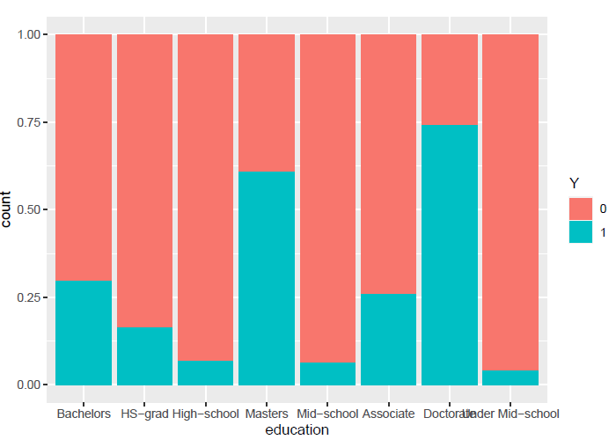
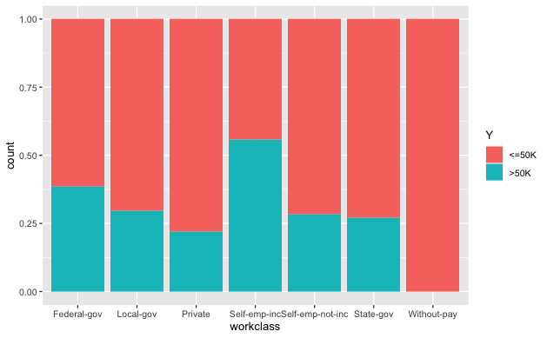
EDA - Bivariate Analysis
There is a big jump in income while having Bachelors degree education
Self employ has a higher chance of having income greater than 50k

Slide 16
EDA - Chi-squared result
Attribute | P-value of Difference < 0.05
Sex | YES
Hours per week | YES
Workclass | YES
Occupation | YES
Marital Status | YES
Education | YES
Race | YES

Slide 17
Modeling
Decision Tree
White
Logistic Regression
12 groups of people
Non - White

Slide 18
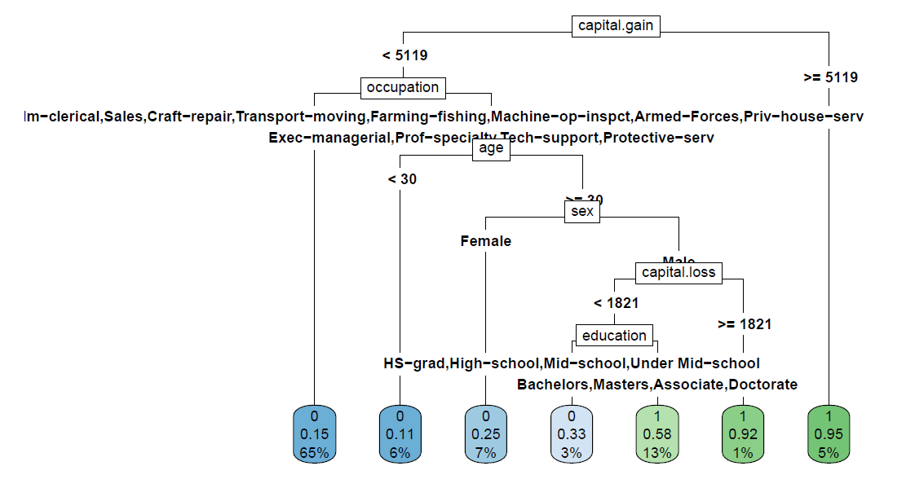
White People Decision Tree
Notes:
Variable important.
Give you most and least important
Conclusion.

Slide 19
Decision Tree for white
Male ages above 30, who has an exec and prof, tech-support job, would have income above 50k even though capital loss is greater than 1821
Capital gain greater than 5119 is very likely to have income greater than 50k
White people who engage in manual labor and capital gain less than 5119 are more likely to have income less than 50k

Slide 20
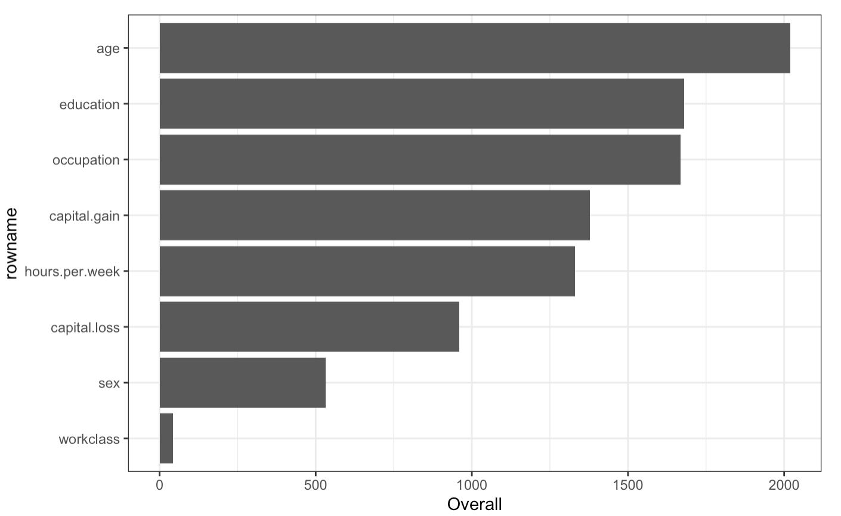
Variable importance - White
Age is the most important factor
Education and occupation are also very important

Slide 21
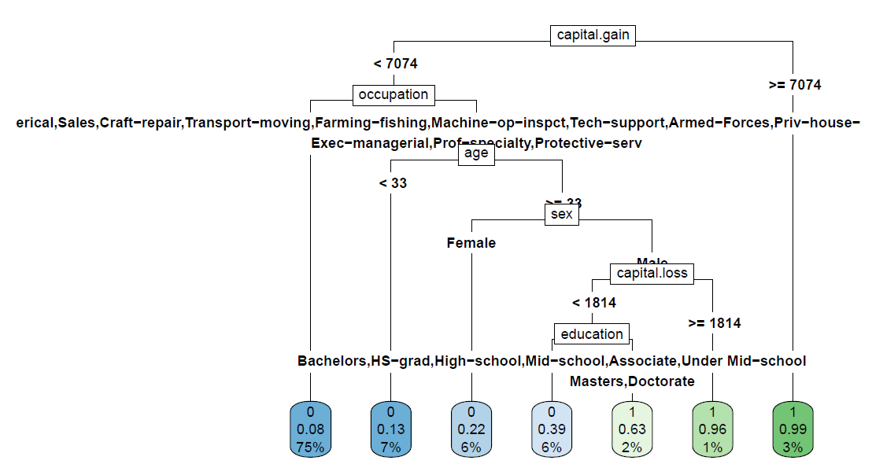
Non-white People
Decision Tree
Notes:
Differnece income for race in eda report

Slide 22
Decision Tree for Non-white
Capital gain greater than 7074 is very likely to have income greater than 50k
Non-white people engaging in manual labor are more likely to have income less than 50k
For non-white people, 75% of their income less than 50k

Slide 23
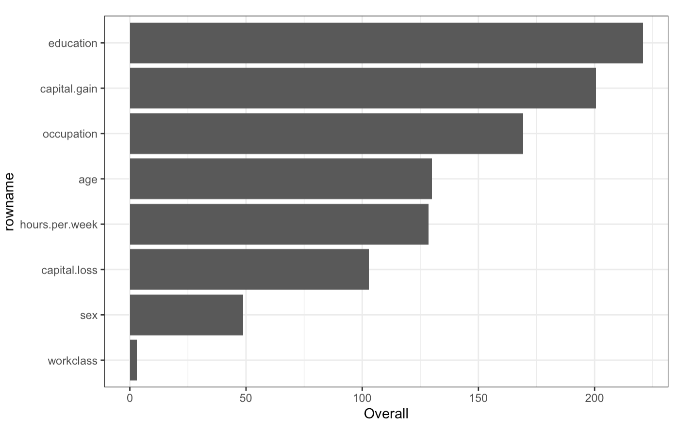
Variable importance – Non-white
Education is the most important factor.
Occupation and Capital gain are also very important.

Slide 24
Logisitic Regression
Age
Sex
12 Groups
Race
Logistic Regression
< 30
30 - 50
> 50
Male
Female
White
Non- white
* Data is separated to white and non – white because 70% of the data are white
Notes:
Logistic 回归
Variance Inflation Factor
Business oriented about

Slide 25
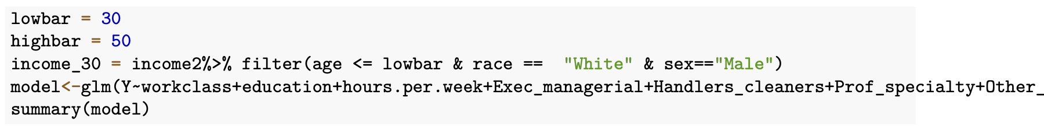
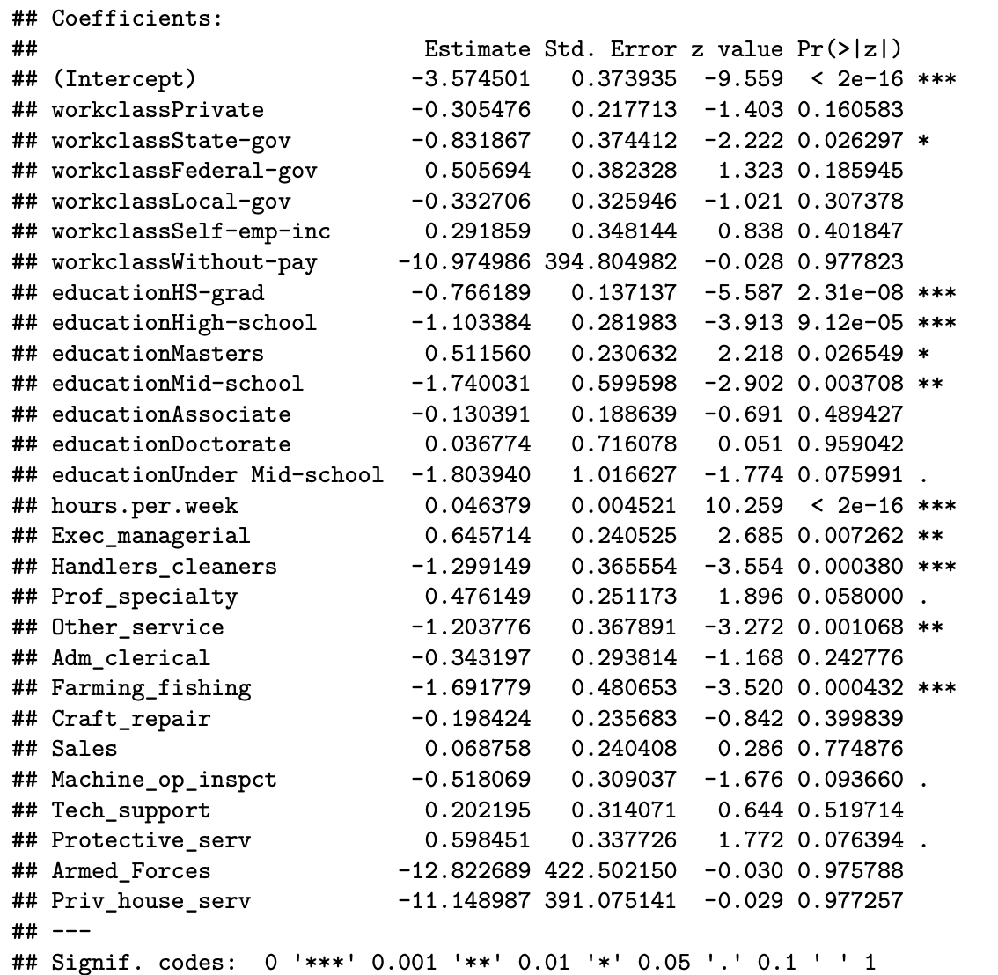
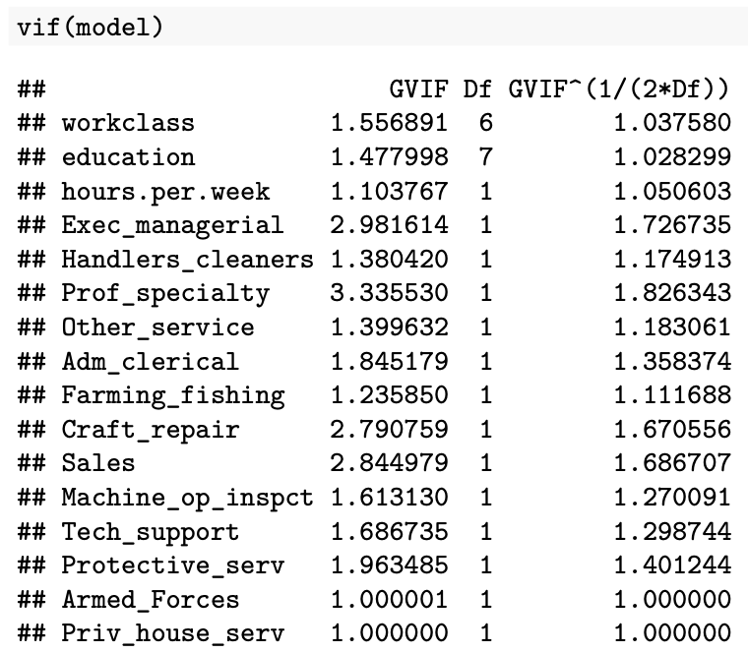

White Male < 30

Slide 26
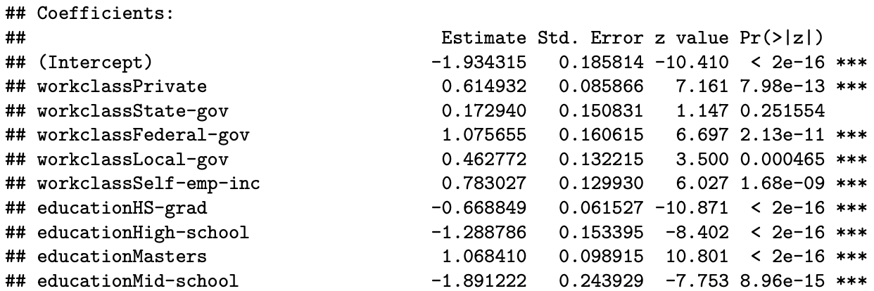
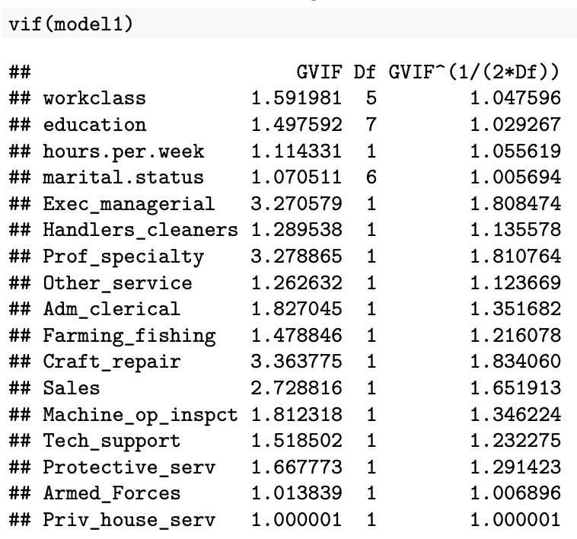
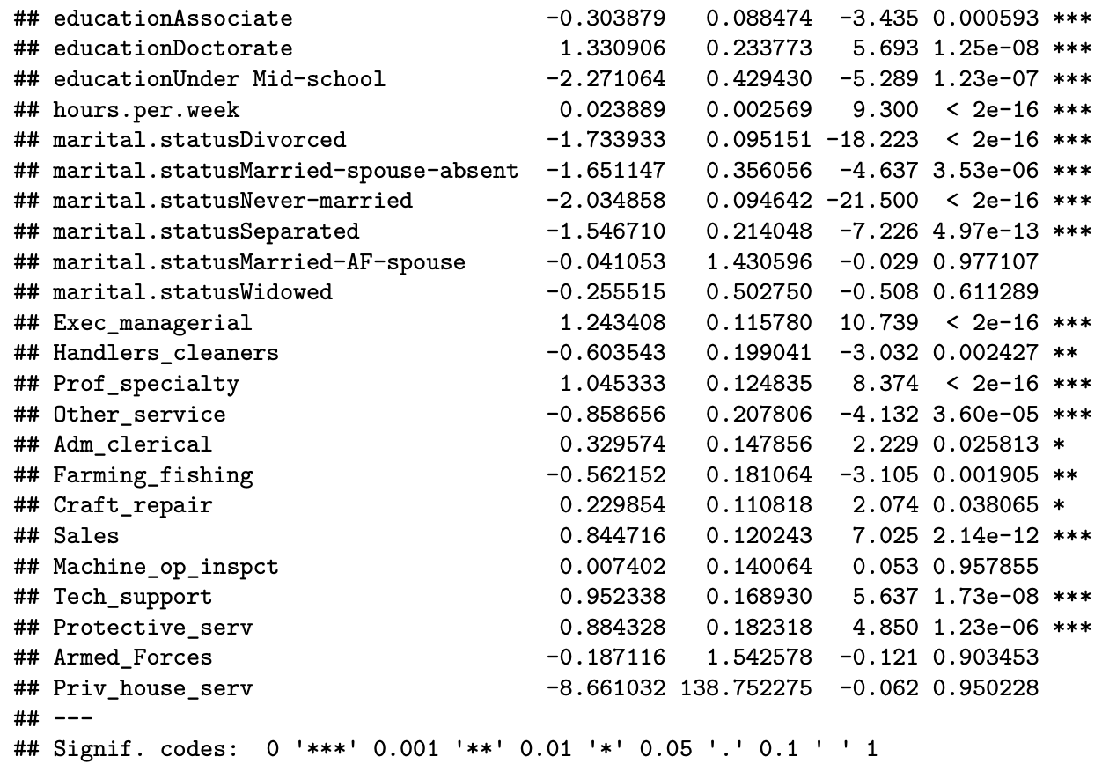
White Male, 30 - 50

Slide 27
Conclusion
 | Suggest | Not suggest
White - Male - age<30 | - Master | - Work without pay - Arm Force - Private House Service
White - Male - age30~50 | - Master - PhD - Work in government - Self-employment - Professional Specialty | - Private House Service
White - Male – age>50 | - PhD - CEO | - Work without pay
White - Female - age<30 | - Master - PhD | - Machine Operation Inspect
White - Female - age30~50 | - Master - PhD - Craft Repair - Professional Specialty | - State Government - Education Associate - Farming-Fishing
White - Female - age>50 | - Master - PhD | - Education High School - Machine Operation Inspect

Slide 28
Conclusion
 | Suggest | Not suggest
Non-White - Male - age<30 | - Machine Operation Inspect | - Federal government - Work without pay - Farming-Fishing
Non-White - Male - age30~50 | - Tech Support - Sales | - Education under Mid School
Non-White - Male - age>50 | - Tech Support - Sales | - Farming-Fishing - Work without pay
Non-White - Female - age<30 | - Farming-Fishing - Private & Government | - Education High School Graduate - Self-Employment - Tech Support
Non-White - Female - age30~50 | - Craft Repair | - Education Mid School - Farming-Fishing - Transport Moving
Non-White - Female - age>50 | - Sales - Government | - Education Associate

Slide 29
Conclusion
Getting higher education is a good choice to raise their incomes, especially Master's degree
Working in highly specialty demanding jobs and working for the government can lead to better income.
Whites and Male have better chance of getting higher income , and they also have more choices when choosing work class.

Slide 30
Appendix

Slide 31
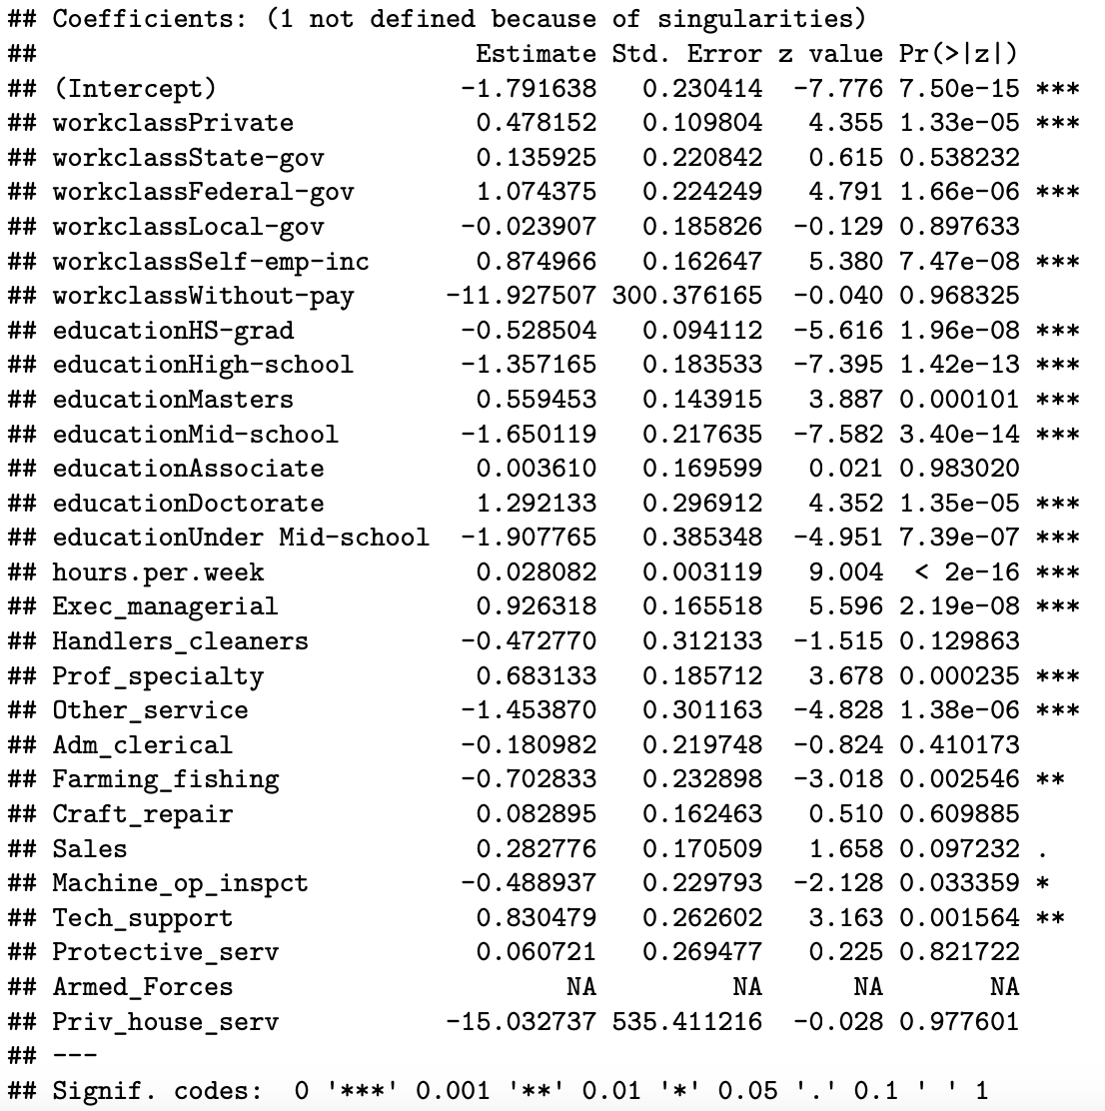
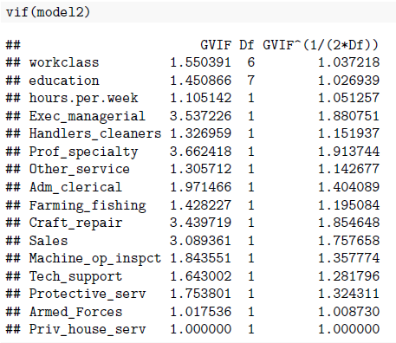
White Male > 50

Slide 32
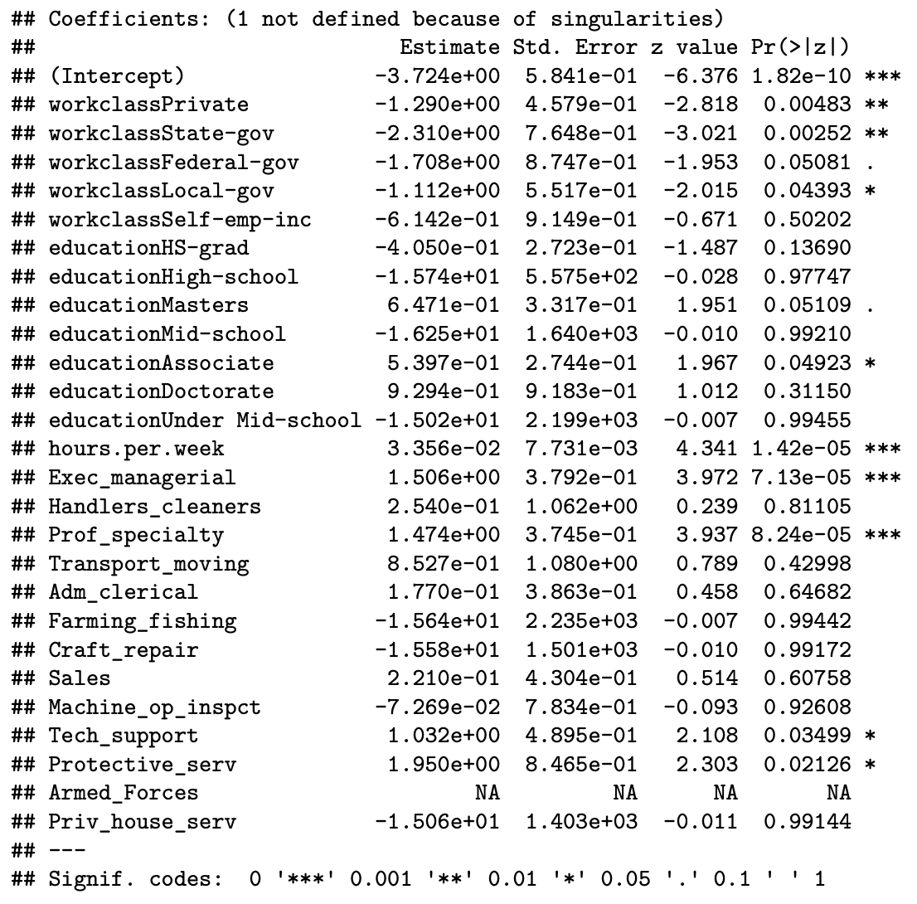

White Female < 30

Slide 33
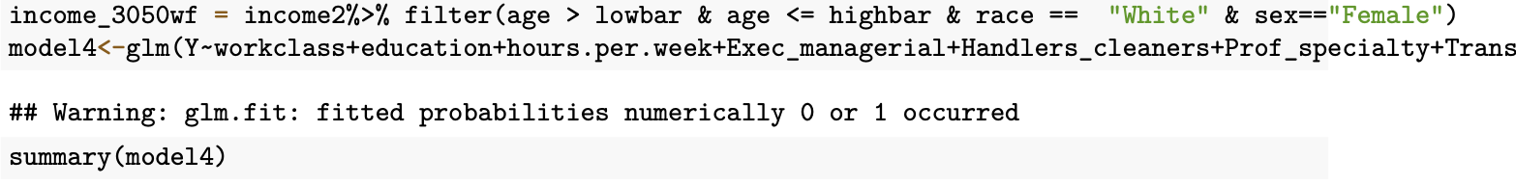
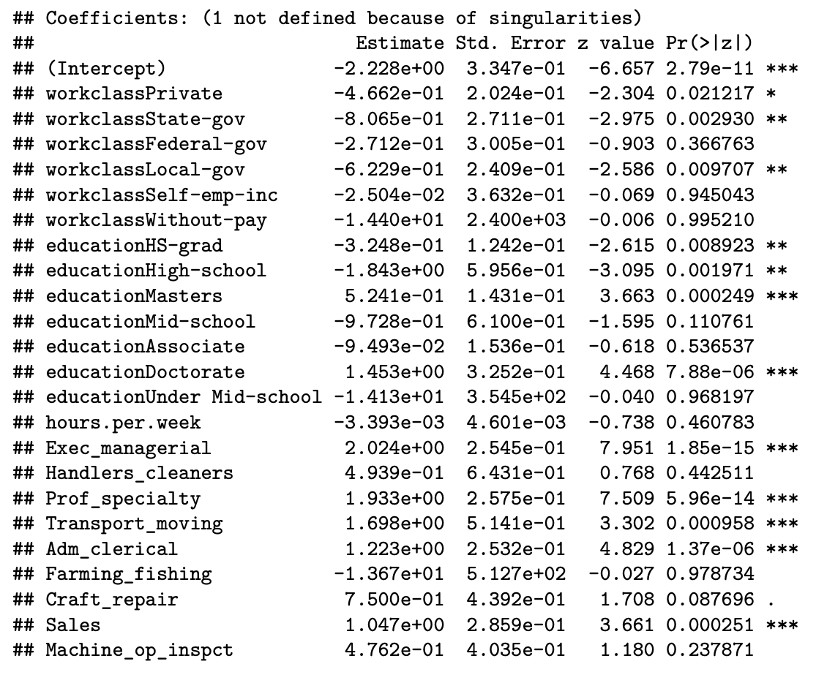
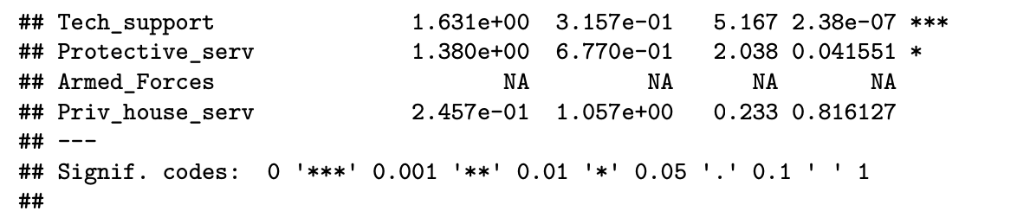
White Female 30-50

Slide 34
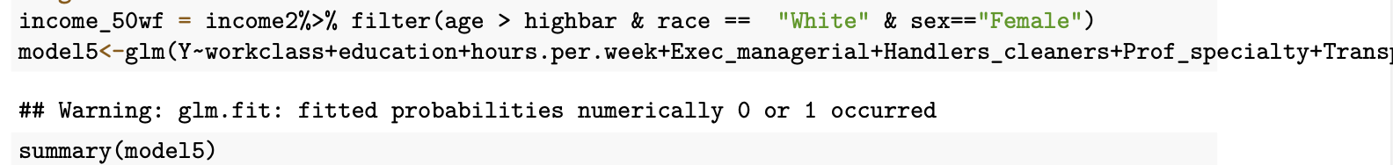
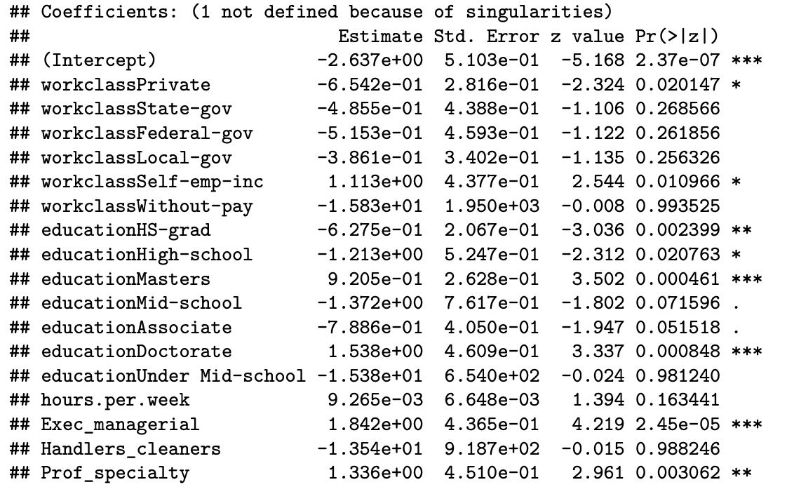
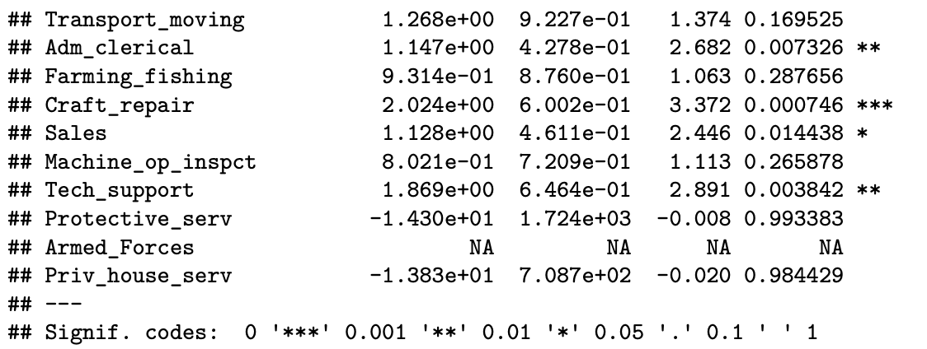
White Female > 50

Slide 35
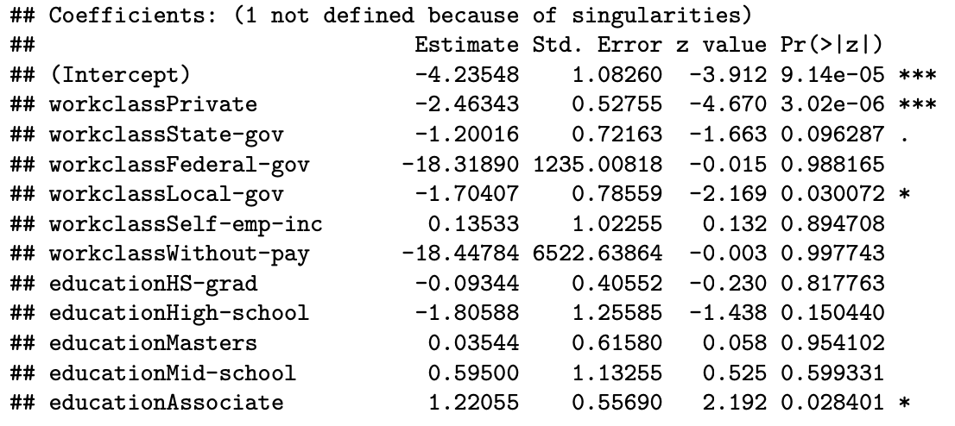
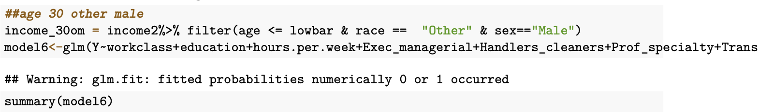
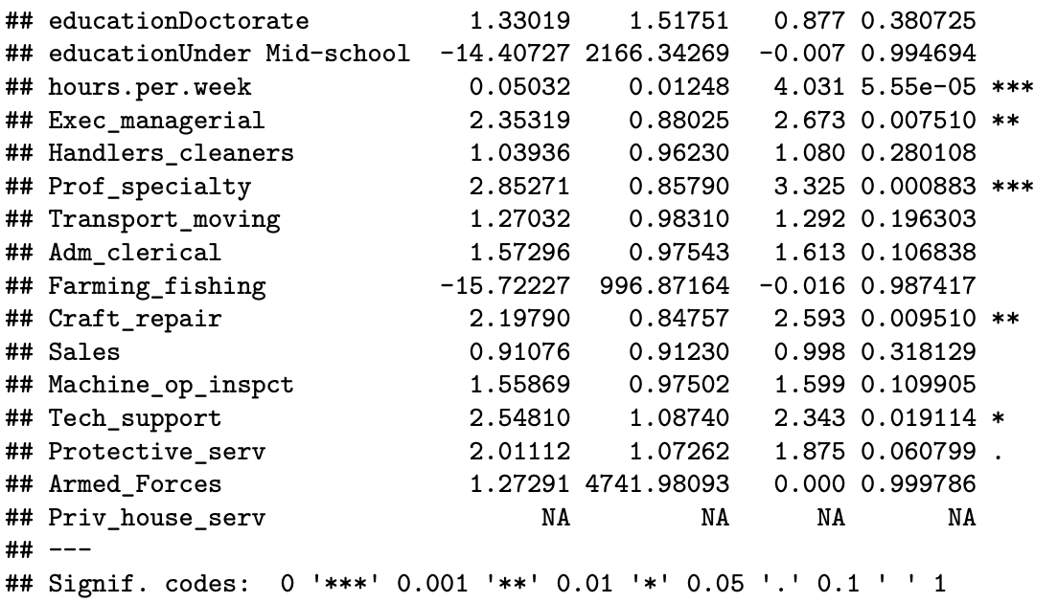

Non- White Male < 30

Slide 36
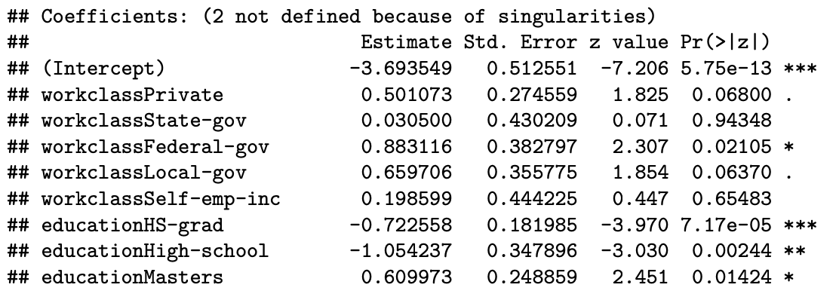
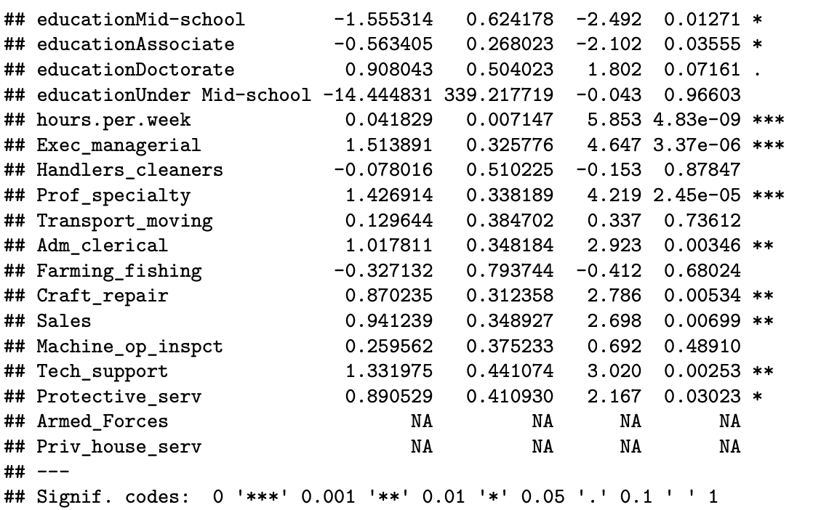
Non- White Male 30 - 50

Slide 37
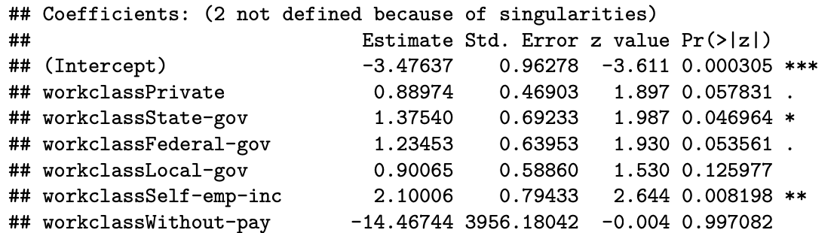
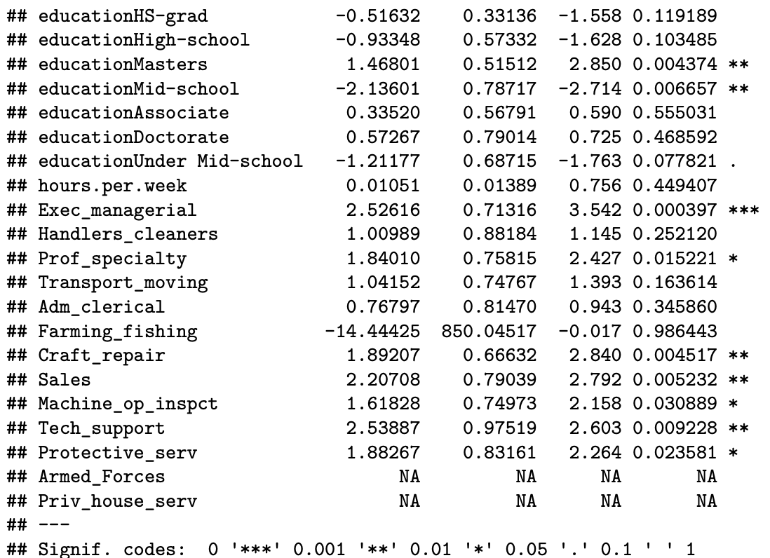
Non – White Male > 50

Slide 38
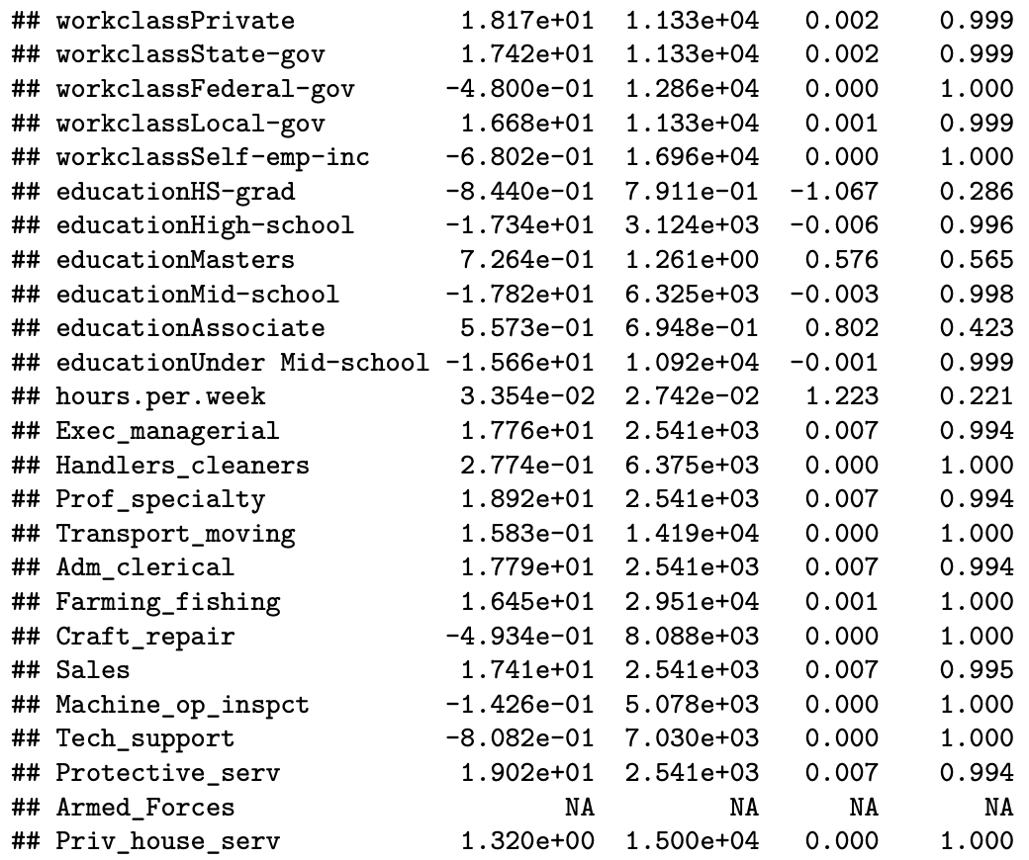

Non - White Female < 30

Slide 39
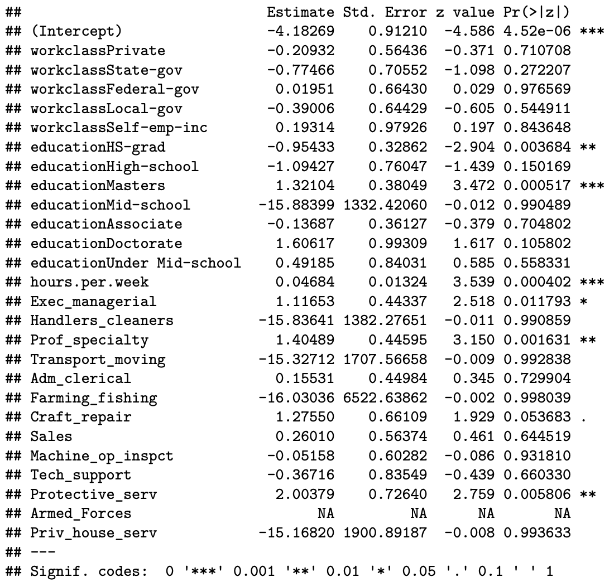
Non - White Female 30-50

Slide 40
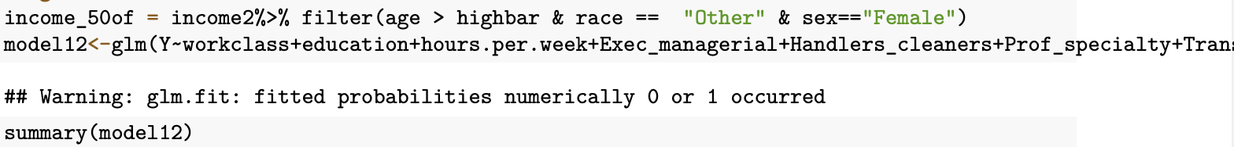
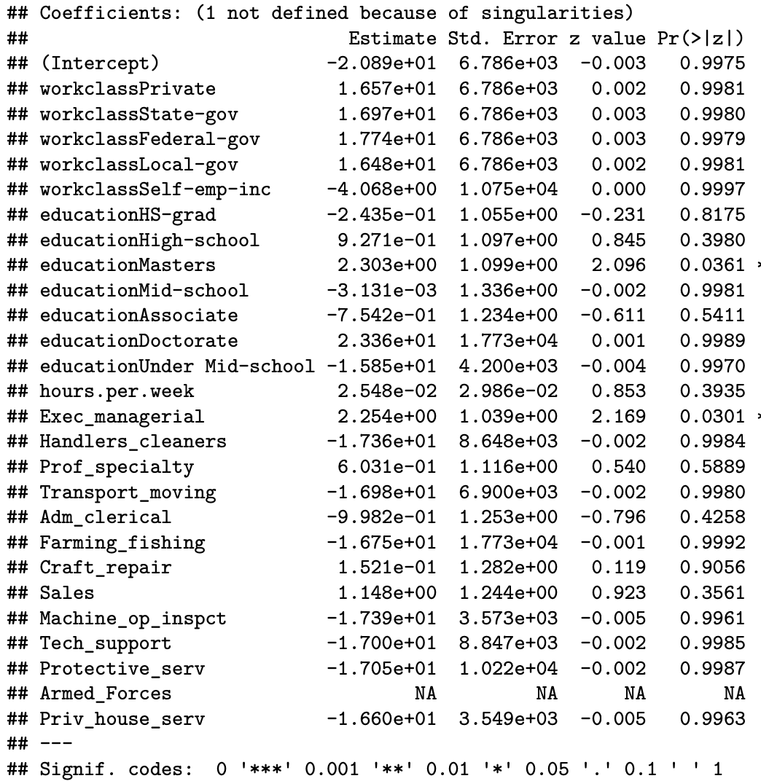
Non - White Female > 50

